Slide 1


Adventure Works Project Overview
This presentation provides an overview of the Adventure Works project, highlighting the various dashboards that have been developed using a range of data analysis tools such as Excel, Power BI, Tableau, and SQL. Emphasis is placed on the principles of effective data visualization and analysis techniques, illustrating how these tools can be utilized to derive insights from complex datasets.
Analyzed the Adventure Works Cycle dataset using SQL, and visualized insights through Tableau, Power BI, and Excel Dashboards.
Focused on key business metrics like Sales, Profit, Production Cost, and Profit Margin (%) across different dimensions:
Demographic (Gender, Marital Status)
Time-based (Year, Month, Quarter)
Geographic (Country)
Product-based (Category and Top Products)
Key Business Insights
Consistent overall profit margin of around 41%, showing stable cost management.
Top 5 Products (mainly Mountain Bikes) contributed significantly to revenue
Bikes category is the most profitable among all product categories.
United States led in both sales and profit, followed by Australia and the UK
Gender & marital status distribution shows nearly equal purchase behavior.
Profit margin improved in 2014 compared to earlier years, indicating better pricing or cost control strategies.

Slide 2




Details of Data Analyst
This slide presents the details of Sumit Sharma, the Data Analyst responsible for creating dashboards for the Adventure Works dataset.
Name
Role
Objective
Sumit Sharma
Data Analyst
Create comprehensive dashboards

Slide 3




Today's Agenda
Build Dashboard on Excel
Build Power BI Dashboard
Create an interactive dashboard using Excel to visualize key metrics and trends from the Adventure Works dataset.
Utilize Power BI to create a robust dashboard that integrates the same dataset, enabling advanced analytics.
1
2
My SQL Analysis
Build Tableau Dashboard
4
3
Perform SQL queries on the Adventure Works dataset to extract valuable insights.
Develop a Tableau dashboard to illustrate the data visually, leveraging powerful visualization capabilities.

Slide 4


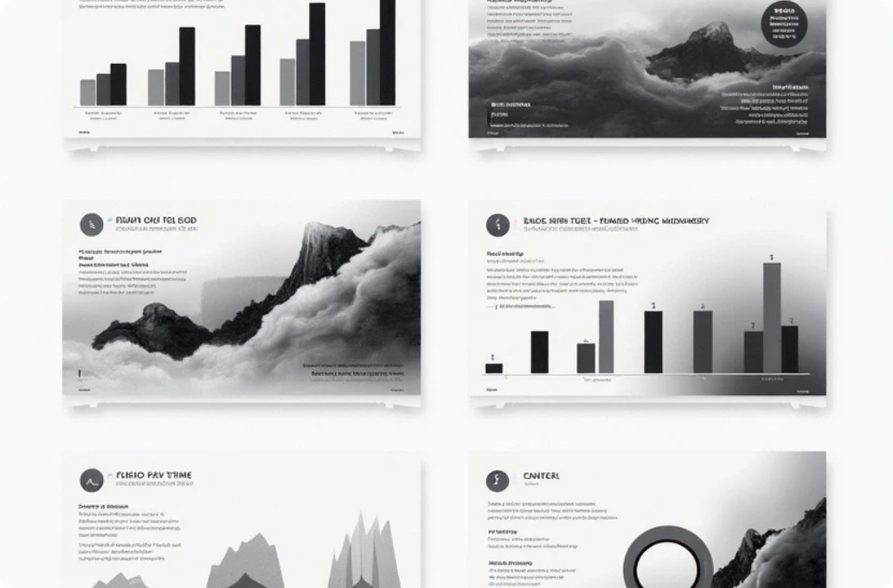

Creating an Excel Dashboard
Data Sources
Visualization Techniques
Interactivity
Identify and connect to relevant data sources within the Adventure Works dataset, ensuring accurate and up-to-date information for analysis.
Use charts, tables, and pivot tables to present data effectively, allowing for easy interpretation of trends and patterns.
Implement features like slicers and dropdowns to enhance user interaction and enable viewers to filter data according to their needs.

Slide 5
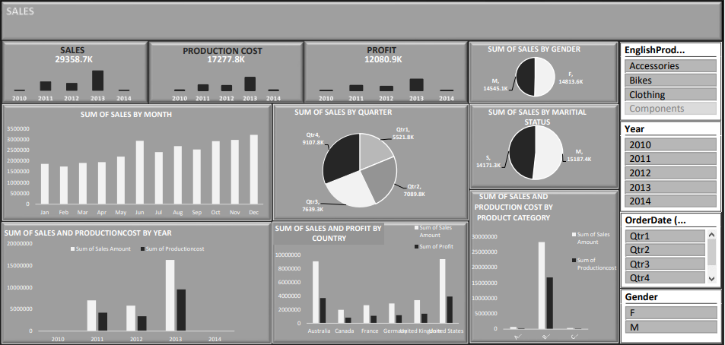
EXCEL DASHBOARD

Slide 6


Power BI Dashboard Overview
Data Modeling
Visual Elements
Structure the Adventure Works dataset in Power BI to optimize performance and improve visualization capabilities.
Incorporate diverse visual elements such as maps, KPI indicators, and custom visuals to provide a comprehensive view of the data.

Slide 7
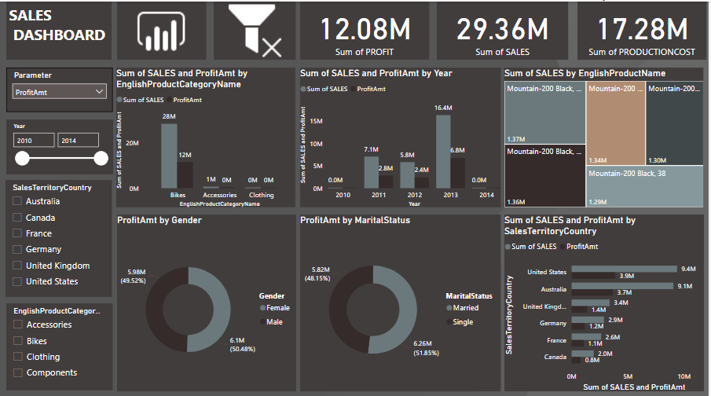
POWER BI DASHBOARD

Slide 8
Tableau Dashboard
Create interactive visualizations that allow users to explore the data in depth, including filters and drill-down features.
Dynamic Visualizations
Data Connection
Connect Tableau to the Adventure Works dataset, ensuring seamless data flow and accessibility for analysis.

Slide 9
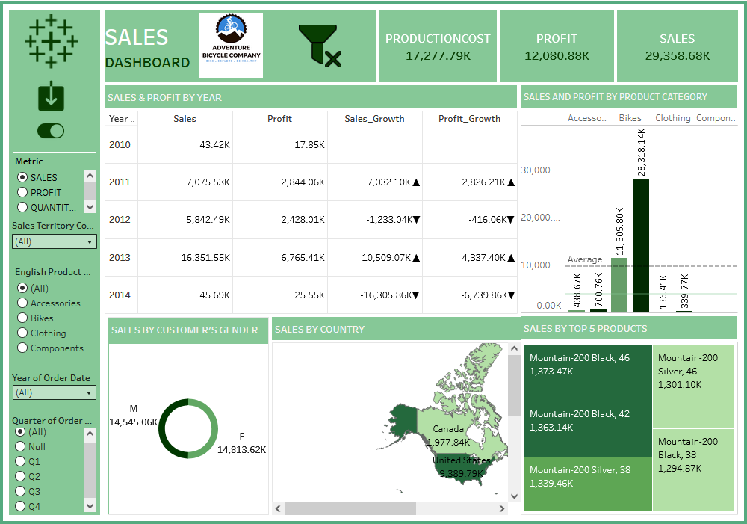
TABLEAU DASHBOARD

Slide 10


SQL Analysis
SQL Analysis involves three main stages: data retrieval, data cleaning, and insight generation. Each stage is crucial for transforming raw data into valuable business intelligence.
1
Data Retrieval
2
Data Cleaning
3
Insight Generation
Execute SQL queries to extract relevant data from the Adventure Works database, focusing on key performance indicators and metrics.
Perform data cleaning and transformation to prepare the data for analysis, ensuring accuracy and consistency in the results.
Analyze the retrieved data to uncover insights that can inform business decisions and enhance strategy development.

Slide 11
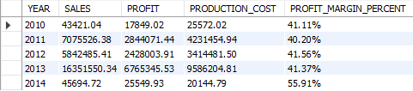
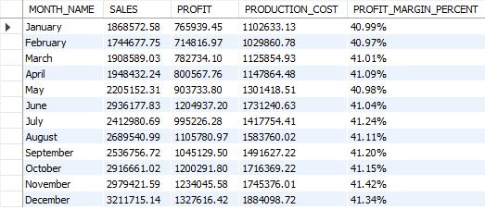
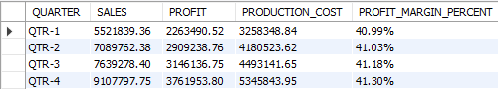
MY SQL ANALYSIS
# Overall Sales, Profit, Production Cost, and Profit Margin (%) – KPI Summary
#Yearly Sales, Profit, Production Cost, and Profit Margin (%)
#Monthly Sales, Profit, Production Cost, and Profit Margin (%)
#Quarterly Sales, Profit, Production Cost, and Profit Margin (%)

Slide 12
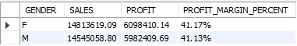
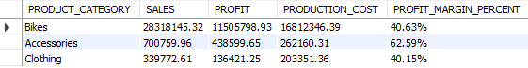
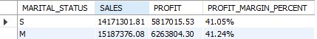
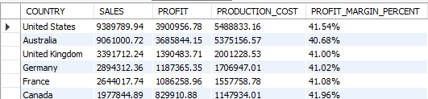
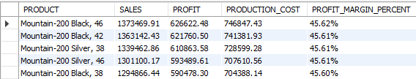
MY SQL ANALYSIS
# Gender-wise Sales, Profit, and Profit Margin (%)
# Product Category Sales, Profit, Production Cost, and Profit Margin (%)
# Marital Status-wise Sales, Profit, and Profit Margin (%)
# Country-wise Sales, Profit, Production Cost, and Profit Margin (%)
# Top 5 Products by Sales with Profit, Production Cost, and Profit Margin (%)

Slide 13

Summary of the Adventure Works Project
The Adventure Works project encompassed the creation of dashboards using various tools for data visualization and analysis. Each tool provided unique capabilities, contributing to a comprehensive understanding of the dataset and impacting decision-making processes and strategic planning within the organization.
Project Overview
Tools Used
Impact on Decision-Making
The project involved creating dashboards.
Tools included Excel, Power BI, Tableau, and SQL.
Insights gained can impact strategic planning.

